Slide 1
GeoForAll Educator Awards for 2015

Slide 2
What is GeoForAll.org?
A global network of Open Geospatial Science Research and Education ‘Labs’ and ‘Partners’
A partnership between OSGeo and ICA
An evolutionary step for the OSGeo’s Education Committee
OSGeo Education Committee and GeoForAll are one and the same

Slide 3
GeoForAll’s Mission
Making Geospatial Science and Education Open to All

Slide 4
GeoForAll Overall Aims
Establishing research and teaching opportunities in ‘Open Geospatial Science’
Build global open access teaching and research infrastructure
Provide worldwide learning platforms and training opportunities
Establish collaborations between Academia, Schools, Government and Industry around Open Geospatial Science and Education

Slide 5
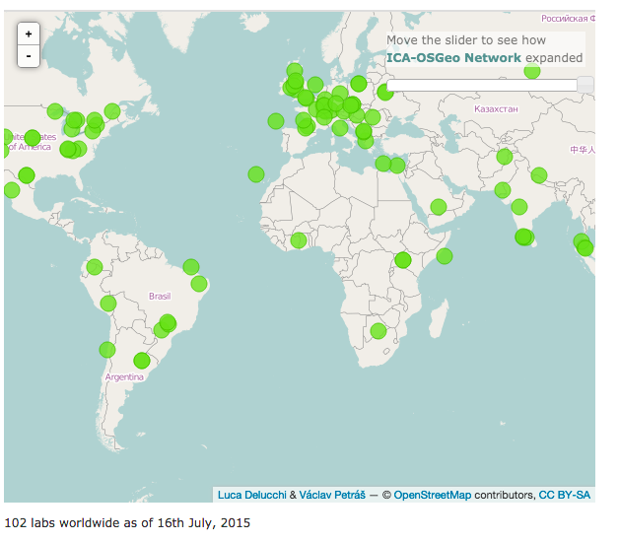
A Reason to Celebrate!
June 2015: We reached 100 labs worldwide
Networking effects!

Slide 6
Educational content sharing... One important component of GeoForAll

Slide 7
GeoForAll Educator Award –
1st year
To recognize educators in the GeoForAll community who are doing important things to move the GeoForAll educational mission forward
Team Award
Individual Award

Slide 8
Educator Award Process
Committee formed
Initial process defined
Nominations accepted
International Committee review
Voting on candidates
Difficult selection process... All nominees are doing GREAT THINGS, and they deserve a shout-out!
New process with a few ‘bumps’... But we learned from this and a committee will work on improving the process for next year

Slide 9
Educator Award
International Committee
(random order)
Georg Gartner (President, ICA)
Jeff McKenna (President, OSGeo)
Chen Jun (President, ISPRS)
Maria Antonia Brovelli (Italy)
Xinyue Ye (USA)
Luciene Delazari (Brazil)
Tuong-Thuy Vu (Malaysia)
Venkatesh Raghavan (Japan/India)
Ivana Ivánová (Brazil)
Jeroen Ticheler (The Netherlands)
Serena Coetzee (South Africa)
Helena Mitasova (USA)
Anne Ghisla (Germany)
Patrick Hogan (USA)
Suchith Anand (UK/India)
Charlie Schweik (USA)
** THANK YOU FOR YOUR
SERVICE COMMITTEE!! **

Slide 10
Nominees – Individuals
(if you are here, stand up and be recognized!)
Daniel Baldwin, Costa Rica International Academy, Costa Rica.
For his “Mapping the Mangroves” course
Phil Davis, DelMar College, Texas, USA
For his leadership and tireless efforts leading the creation of the GeoAcademy
Genovevea Laurente, Consultora Calixto, Uruguay and gvSIG Batovi
For the course “Sistemas de Información Geográfica con uso de datos abiertos orientado a la educación,” or in English, “Geographic Information Systems for Education using Open Data”
Kurt Menke, Bird’s Eye View GIS, Alburquerque, NM, USA
For his Introduction to Open Source and Web Mapping course he developed for Central New Mexico Community College
Sterling Quinn, Pennsylvania State University, Pennsylvania, USA
For his course on “Open Web Mapping”
Giorgio Zamboni, Politecnico di Milano, Como campus, Italy
For his “PoliCrowd: A Social Network App with NASA World Wind.

Slide 11
Nominees – Teams
(if you are here, stand up and be recognized!)
Environmental Information Centre, UNEP/GRID Warsaw
For their EduGIS Academy
The Open Source Geospatial Laboratory team at ETH Zurich, Switzerland
For their Interactive Web Maps course
Shashi Shekhar and Brent Hecht, Computer Science, University of Minnesota, USA
For their Massive Open Online Course “From GPS and Google Maps to Spatial Computing”
Lluis Vicens (SIGTE,Spain), Toni Hernandez (SIGTE, Spain), Jeremy Morley (University of Nottingham,UK), Alberto Romeu (Prodevelop) and Jorge Sanz (Prodevelop)
For their GIS Open Source Summer School at the University of Girona in Spain
Ricardo Olivira, Raphael Moreno - FOSS4G lab, University of Colorado, Denver USA
For their PostgreSQL/PostGIS course materials
Raquel Sosa, Rosario Casanova and Jorge Franco
For their gvSIG Educa/Batovi effort in Uruguay
Kurt Menke - Bird's Eye View, Nate Jennings Urbandale Spatial, Jon Van Hoesen Green Mtn College, Rick Smith Texas A&M, and Phil Davis, Delmar College
For their GeoAcademy development efforts

Slide 12
Nominees
All of you are deserving!
Coming soon:
A ‘roll of honor’ listed on the GeoForAll website of all nominees.
CV:
Nominated, GeoForAll Educator of the Year, 2015, with a link to the ‘roll of honor’

Slide 13
The GeoForAll Individual Educator of the Year Award goes to…

Slide 14
GeoForAll Individual Educator
of the Year Award - 2015
Sterling Quinn, Pennsylvania State University, Pennsylvania, USA
For his course on “Open Web Mapping”
He couldn’t make it here – today is the final day at his Oxford summer doctoral program
Video…

Slide 16
The GeoForAll Educator of the Year Team Award goes to…

Slide 17
GeoForAll Team Educator
of the Year Award - 2015
Kurt Menke - Bird's Eye View, Nate Jennings Urbandale Spatial, Jon Van Hoesen Green Mtn College, Rick Smith Texas A&M, and Phil Davis, Delmar College (all in USA)
For their GeoAcademy development efforts
fossgeo.org

Slide 18
Three very quick last items....

Slide 19
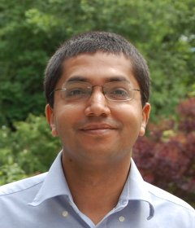
1. A BIG shout-out to GeoForAll’s leader Suchith Anand (University of Nottingham) GeoForAll would not be at 100+ labs without his tireless efforts

Slide 20
2. GeoForAll Logo competition Thank you to all who submitted entries! And thank you to the designer of the winning logo! Silvia Guerini

Slide 21
3. On behalf of the entire conference, the GeoForAll community wanted to thank Maria Brovelli (and the Como team!) for their efforts in making the FOSS4G EU conference such a success!

