Slide 1
GEOBADGES ISSUER GUIDEBOOK _____________________
CREATE. SHARE. REVIEW.

Slide 2
YOUR CHECKLIST
Create
  Log on to the American Geographical Society Credly Account.
  Create your badge
  Create a place-holder icon
  Decide on a name and description
  Add more detail
  Determine how you will issue your credit
Share
  Embed them on your own site
  Develop lessons that help earners build skills
  Directly issue your badge with Claim codes
Review
  Notification of evidence
  Acceptance

Slide 3
CREATE

Slide 4

CREATE
Go to www.credly.com and log in as an Issuer

Slide 5
CREATE
Create a new badge.

Slide 6
CREATE
Give your badge a name and description

Slide 7
EARN
Provide more information about your badge, either by typing it in or adding external links. Also, assign Categories that will help earners filter for your badge.

Slide 8
EARN
After clicking the “allow others to claim this credit” button, proceed to decide how you will issue your badge. You can issue it automatically, or require the earner to provide evidence that you review. You can also generate “claim codes”.

Slide 9
CREATE
That’s it! Once you save your work, your GeoBadge will appear at www.geobadges.org for everyone to find and earn!

Slide 10
SHARE

Slide 11
SHARE
Embed your badges on your own site

Slide 12
SHARE
Add to your Description to help earners practice and build the skills you want to recognize

Slide 13
SHARE
Directly award badges to others, without them having to lift a finger.

Slide 14
REVIEW

Slide 15
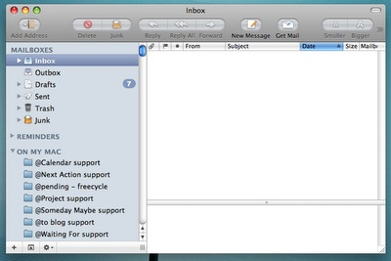
REVIEW
Receive notifications and review evidence

Slide 16
Review
Accept, or reject and notify.

Slide 17
GEOBADGES GUIDEBOOK _____________________
EARN. CREATE. ISSUE.

